Slide 1

Meet the Teacher
Welcome to
Year 1

Slide 2
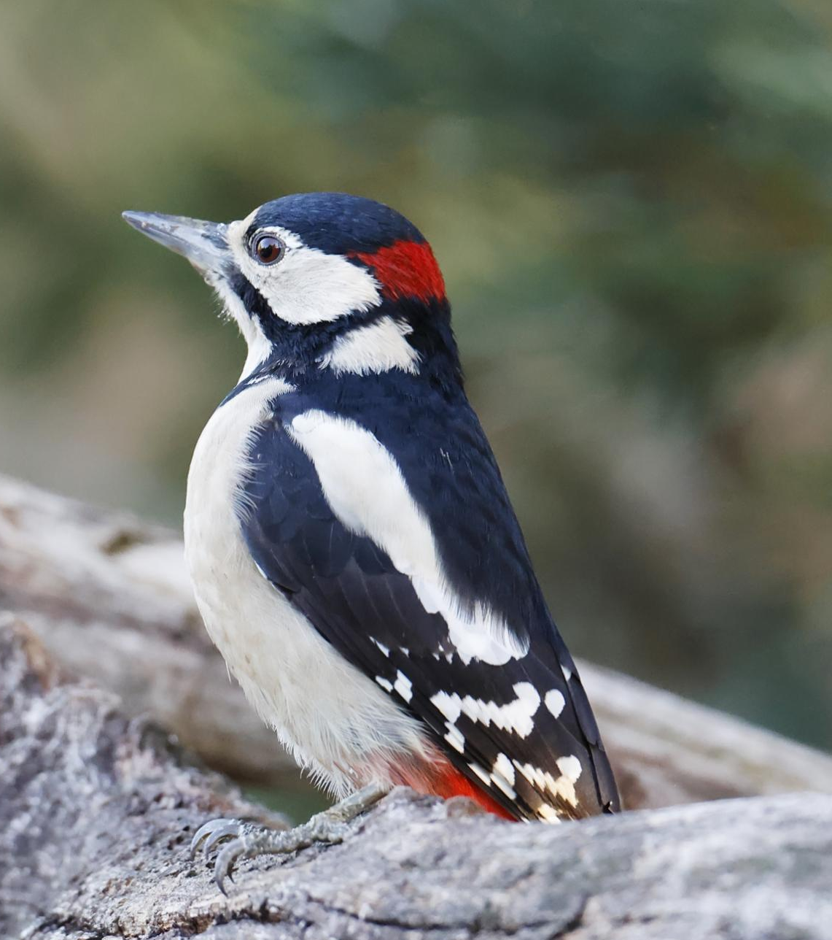
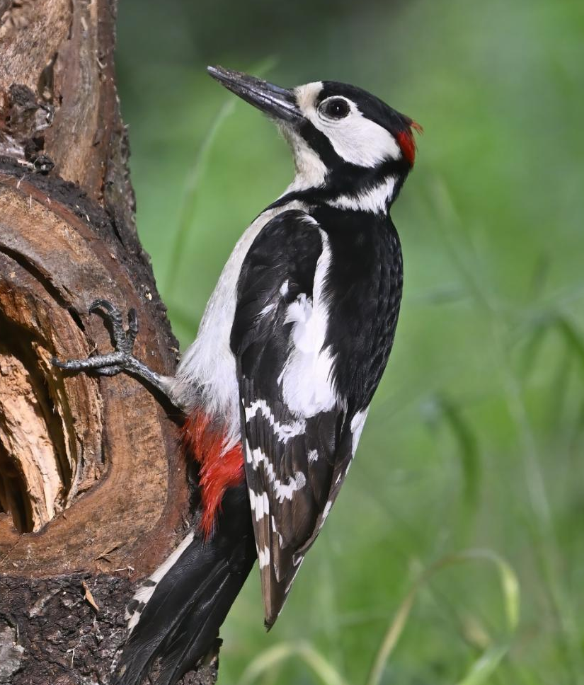
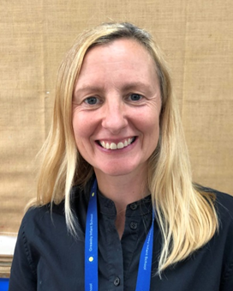
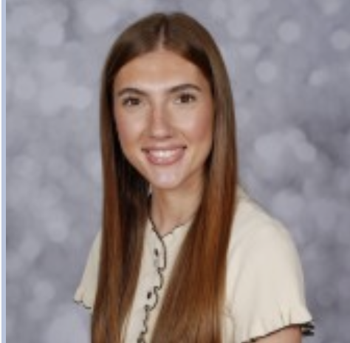
Welcome to Y1 Woodpeckers
I’m Miss Dunne and I have worked with Mrs Clark in Y1 for the past year. I have a 2 year old little girl so I love bringing that care and nurturing feel to the classroom allowing children to grow in confidence and independence. I love reading, art and teaching science.
Welcome!
I’m Mrs Clark and I love teaching Year 1. This is a wonderful year where the children make so much progress. I have 2 wonderful children of my own who are about to fly the nest. I love languages, travel, books and theatre.
Mrs Clark
Miss Dunne

Slide 3

Our New Vision

Slide 4

School Rules
Ready, Respectful, Safe
Ready – Correct uniform, reading book, listening, lining up
Respect – For our school community and our environment
Safe – Looking after each other, online safety, stranger danger

Slide 5
Topic outline for this year will be:
Autumn – Daily Maths & Literacy.
Science - Materials and seasonal changes
Geography - Our School/Mapping & Our Local Area (including walk)
History - History of Toys. School days past and present.
PE, Art/DT, Music, Spanish, Computers, Jigsaw, Happy Minds.
Spring – Daily Maths & Literacy.
Science - Animals including humans.
Geography - THe UK & Its Seas. Seasons.
History - Technological artefacts. History of Space
PE, Art/DT, Music, Spanish, Computers, Jigsaw, Happy Minds.
Summer – Daily Maths & Literacy.
Science - Plants and seasonal changes.
Geography - Hot & Cold Places. Australia & UK
History - Grace Darling & lifeboats. Local history & History of the seaside.
PE, Art/DT, Music, Spanish, Computers, Jigsaw, Happy Minds.
Curriculum overviews for each half term will be on the class page on the school website. The link to this will be sent out each half term alongside any key information and PE days.

Slide 6
Trips
This year we will be visiting:
Autumn Term – Whole school cinema trip
Spring Term – Zoo Lab visit
Summer Term – Knowsley Safari Park (to be confirmed).
We will always try and keep trips to the minimum cost. Please speak to us if any issues.
We will inform you about local visits (e.g. church) as well. Walkers are always needed so please let us know if you can help!

Slide 7

PE will usually be on :
Mondays and Wednesdays this half term
Your child will need the following items named:
White t-shirt, black shorts/jogging bottoms/leggings, trainers/pumps and a school jumper/cardigan.
Children to come in to school on PE days in their PE Kit.
Sports Club Days – if it is not their PE day children need to bring their kit in to get changed into after school.

Slide 8
HOMEWORK
Half-termly homework will be found on our website at the start of each half term.
In addition to this, Star Words (common exception words) will be sent home every other Friday for the children to practise reading and spelling.
Children to bring back their homework books on a Wednesday. The work will be looked at throughout the half term.

Slide 9


Reading in year ……:
Each child is expected to ‘Strive for five’ –
this means
reading at least 5 times a week at home.
Reading Records are provided so that you can document when your child reads. Sometimes staff will comment if your child is reading individually.
Reading books and records are to be handed in on Thursday, and will be given out on a Friday. Reading books will match your child’s phonetic ability.

Slide 10
Water Bottles
Please make sure that these are named – water or sugar free cordials/squash only. No fizzy drinks please. Drinks will be stored and children will have regular access to them at appropriate times.
Snacks
Fruit is available for snack at break time.
Label
Please label clothes (especially jumpers).
School Meals
The menu is available, please discuss the choices with your child so they are familiar with their choices. We will endeavour to let you know any changes ahead of the day.
We have children in the school with severe anaphylactic allergies.
Please remember we are a NUT FREE SCHOOL and to be mindful of products with eggs and milk. If you wish to send anything in to celebrate birthdays we are asking to choose small sweets rather than cakes.
Please note that we are also unable to give out lists/names for birthday parties due to GDPR.

Slide 11
Friday Assembly
Each week we will pick two of our children to receive an award for a special achievement that week – one linked to our curriculum and learning and another for a child that has ‘shone bright’ that week.
Parents will be informed on a Friday and can attend the assembly the following Friday at 2:40pm.
The children who receive a certificate will have a small treat and time to share their learning the following week with Mrs Grimster or Mrs Cooper.

Slide 12
Time off school
In case of illness: phone school office before 9.30am
Requested time off school: please complete the request form available online or from the office.
We are expected to issue Fixed Penalty Notices for more than 10 sessions (1 day = 2 sessions) of unauthorised absence in a ten week period.
We do monitor late arrivals and those who have regular time off school and will be in touch where necessary to offer support.
The gate opens at 8.40am and closes at 8.55am. There are learning activities in classrooms from 8.40am so please ensure a prompt arrival.
We are only able to administer medication if it has been prescribed for 4 times a day. Please keep us updated with any health information e.g. asthma diagnosis

Slide 13
Communication and Progress
As a school we want to keep parents and carers up-to-date with their child’s education and what is happening in school.
All information will be sent through E-Schools emails or Tapestry in F”
At the start of each half term your class teacher will send you a message regarding all information for that half term and the link to the class page for curriculum information
Important Dates poster overview will be sent out each half term
Fortnightly newsletter
A member of staff on the doors every morning to pass important messages to and Mrs Grimster will be on one of the gates too
Follow our Greasby Infant School Facebook page for celebrations of what we have been up to!
Invitation to our praise assembly if your child is receiving one of the certificates. These will be sent on a Friday evening for the following Friday.
Termly events to share and celebrate your child’s learning.
2 Parents Evenings – November and March 3:30-6:00pm.
One end of year report with option for meeting from this if needed.
If the class teacher has any concerns regarding your child’s progress they will arrange a meeting with you to discuss about steps to support them

Slide 14
Questions and Concerns
If you have questions or concerns please let us know so these can be dealt with promptly. Please understand that a teacher or member of staff may not be able to respond on the same day due to their teaching commitments and will not answer outside of their working hours.
Parental ‘What’s app’ groups are very helpful but please come directly to school staff with questions e.g. Why is my child having a baked potato each day?
Parent partnership is very important to us and we ask all parents/carers to follow our Parent Code of Conduct and procedures we have in place. In particular, please take care when parking and ensure not parking on corners, in zoned areas and over people’s drives.

Slide 15
Who to speak to at Greasby…
First port of call should always be your child’s teacher.
Headteacher – Mrs Grimster
headteacher@greasby-infant.wirral.sch.uk
Deputy Headteacher – Mrs Cooper
scooper@greasby-infant.wirral.sch.uk
SENCO – Miss Jones
hjones@greasby-infant.wirral.sch.uk
School Office
schooloffice@greasby-infant.wirral.sch.uk

Slide 16

FOGIS
Involving yourself with the FOGIS is important.
If you would like to get involved please email
fogis2023@gmail.com
_____
We need your support ~ thank you.

Slide 17
YEAR 2 SAT’s
There are no compulsory SATs tests for Year 2.
We will still use the tests to support our teacher assessment judgements.

Slide 18



Great Websites :
Spelling Frame
BBC Bitesize
Spell Zone (word lists)
The School Run
(for parents!)
Great Apps :
Squeebles
Hit the Button
Doodle Maths

