Slide 1



Welcome to Year 2 ☺
Year 2 staff:
Skylarks: Mrs Whelan, Mrs Pollitt & Mrs Williams
Starlings: Mrs Brandreth, Mrs Butler & Mrs Tuhoy
A member of our team will be on the year 2 door every morning to greet you.

Slide 2

Our New Vision

Slide 3
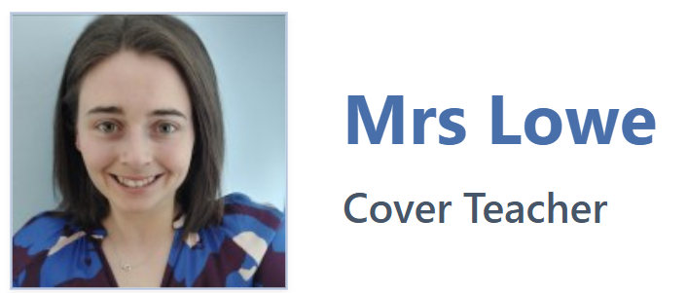
New Staff Member!
Mrs Lowe is a very welcome new addition to our school.
She will be teaching Starlings and Skylarks for one hour each on a Wednesday afternoon.

Slide 4

School Rules
Ready, Respectful, Safe
Ready – Correct uniform, reading book, listening, lining up
Respect – For our school community and our environment
Safe – Looking after each other, online safety, stranger danger

Slide 5
Topic outline for this year will be:
Autumn – Oceans & continents, life cycles.
Spring – The Great Fire of London, plants/habitats.
Summer – Whole school topic TBC
Curriculum overviews for each half term will be on the class page on the school website.
The link to this will be sent out each half term alongside any key information and PE days.

Slide 6
Trips
This year we will be visiting:
Autumn Term – Whole school cinema trip
Spring Term – Library trip
Summer Term – TBC
We will always try and keep trips to the minimum cost. Please speak to us if any issues.
We will inform you about local visits (e.g. church) as well. Walkers are always needed so please let us know if you can help!

Slide 7

PE will usually be on :
Mondays and Thursdays (Skylarks)
Mondays and Wednesdays (Starlings)
Your child will need the following items named:
White t-shirt, black shorts/jogging bottoms/leggings, trainers/pumps and a school jumper/cardigan.
Children to come in to school on PE days in their PE Kit.
Sports Club Days – if it is not their PE day children need to bring their kit in to get changed into after school.

Slide 8
HOMEWORK
Spelling - Homework will consist primarily of learning to spell the year 2 common exception words and learn common spelling rules.
Maths - worksheets, consolidating recently taught concepts, will also be sent out from time to time throughout the year.
Reading – reading regularly throughout the week will help build the speed and accuracy required to progress through the book bands. Please make reading homework a priority!
Homework will be sent home on Fridays and we ask that it is returned each Wednesday.
Please can we ask that loose sheets be glued/sellotaped in at home – thank you ☺

Slide 9


Reading in year 2
Each child is expected to ‘Strive for five’ – this means
reading at least 5 times a week at home.
Reading records are provided for recording these and staff will also record if your child is heard in school.
These will be handed in on a Thursday and given out on a Friday. Reading books will match your child’s phonetic ability.

Slide 10
Water Bottles
Please make sure that these are named – water or sugar free cordials/squash only. No fizzy drinks please. Drinks will be stored and children will have regular access to them at appropriate times.
Snacks
Fruit is available for snack at break time.
Label
Please label clothes (especially jumpers).
School Meals
The menu is available, please discuss the choices with your child so they are familiar with their choices. We will endeavour to let you know any changes ahead of the day.
We have children in the school with severe anaphylactic allergies.
Therefore, please remember we are a NUT FREE SCHOOL and to be mindful of products with eggs and milk. If you wish to send anything in to celebrate birthdays we are asking to choose small sweets rather than cakes.

Slide 11
Friday Assembly
This year, we have adapted our certificate system to help reduce anxiety for children who may worry that they will not receive a certificate.
Each class will have a Class Celebration Pot containing the names of all the children. Two names will be chosen at random each week. The class will then have the opportunity to discuss and celebrate why those children deserve to be recognised.
The children will decide whether each child should receive a Growing Minds Certificate or a Happy Hearts Certificate.
The aim is to ensure that every child has an opportunity to be recognised and celebrated. Rather than certificates being something children feel they have to “earn” through a particular achievement, we want to develop a culture where children notice, appreciate and celebrate the wonderful qualities and achievements of one another.
This approach reflects our school vision of Growing Minds, Happy Hearts, Bright Futures and reinforces the message that every child has something special to celebrate.
Parents will be informed on a Wednesday and can attend the assembly the following Friday at 2:40pm.
The children who receive a certificate will have a small treat and time to share their learning the following week with Mrs Grimster or Mrs Cooper.

Slide 12
Time off school
In case of illness: phone school office before 9.30am
Requested time off school: please complete the request form available online or from the office.
We are expected to issue Fixed Penalty Notices for more than 10 sessions (1 day = 2 sessions) of unauthorised absence in a ten week period.
We do monitor late arrivals and those who have regular time off school and will be in touch where necessary to offer support.
The gate opens at 8.40am and closes at 8.55am. There are learning activities in classrooms from 8.40am so please ensure a prompt arrival.
We are only able to administer medication if it has been prescribed for 4 times a day. Please keep us updated with any health information e.g. asthma diagnosis

Slide 13
Communication and Progress
As a school we want to keep parents and carers up-to-date with their child’s education and what is happening in school.
At the start of each half term your class teacher will send you a message regarding all information for that half term and the link to the class page for curriculum information
Important Dates poster overview will be sent out each half term
Fortnightly newsletter from Mrs Grimster
A member of staff from Year 2 will on the doors every morning to pass important messages to. Mrs Grimster will also be on one of the gates wherever possible.
Follow our Greasby Infant School Facebook page for celebrations of what we have been up to!
*Please note that we are unable to give out lists/names for birthday parties due to GDPR.

Slide 14
Communication and Progress
We will send out an invitation to our praise assembly (via email) if your child is receiving one of our certificates. These will be sent on a Wednesday evening for the following Friday.
We open up the classrooms throughout the year to share and celebrate your child’s learning or to involve families with special events (i.e. mother’s day etc).
There are two parents evenings over the course of the year – these are in November and March, between 3:30-6:00pm.
You will receive an end of year report with option for meeting with from this if needed.
If we have any concerns regarding your child’s progress at any point throughout the year, we will arrange a meeting with you to discuss about steps to support them

Slide 15
Questions and Concerns
If you have questions or concerns please let us know so these can be dealt with promptly. Please understand that a teacher or member of staff may not be able to respond on the same day due to their teaching commitments and will not outside of their working hours.
Parental ‘What’s app’ groups are very helpful but please come directly to school staff with questions.
Parent partnership is very important to us and we ask all parents/carers to follow our Parent Code of Conduct and procedures we have in place. In particular, please take care when parking and ensure not parking on corners, in zoned areas and over people’s drives.

Slide 16
Who to speak to at Greasby…
First port of call should always be your child’s teacher.
Headteacher – Mrs Grimster
headteacher@greasby-infant.wirral.sch.uk
Deputy Headteacher – Mrs Cooper
scooper@greasby-infant.wirral.sch.uk
SENCO – Mrs Jones
hjones@greasby-infant.wirral.sch.uk
School Office
schooloffice@greasby-infant.wirral.sch.uk

Slide 17

FOGIS
Involving yourself with the FOGIS is important.
If you would like to get involved please email
fogis2023@gmail.com
_____
We need your support ~ thank you.
FOGIS

Slide 18
YEAR 2 SAT’s
There are no compulsory SATs tests for Year 2.
We will still use the tests to support our teacher assessment judgements.

Slide 19

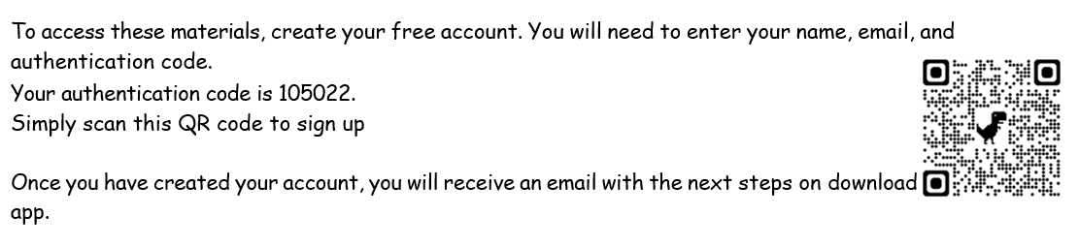
Please scan the QR code to download the parent app for lots of information and tips to help!

Slide 20



Great Websites :
Spelling Frame
BBC Bitesize
Spell Zone (word lists)
The School Run
(for parents!)
Great Apps :
Squeebles
Hit the Button
Doodle Maths

