Slide 1

Meet the Teacher
Welcome to
Foundation 2
Robins and Kingfishers

Slide 2


Slide 3
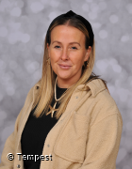
A warm welcome back from
Mrs Grimster
Mrs Grimster is excited to have joined the school family from September 2024 and is looking forward to getting to know, and working with the pupils, staff, families and community friends during the Autumn Term.

Slide 4
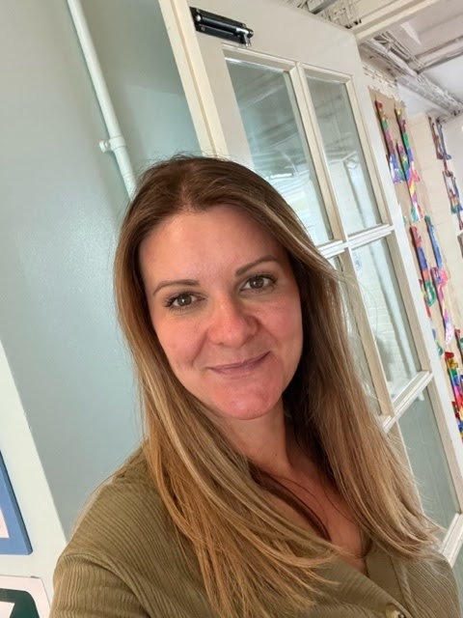
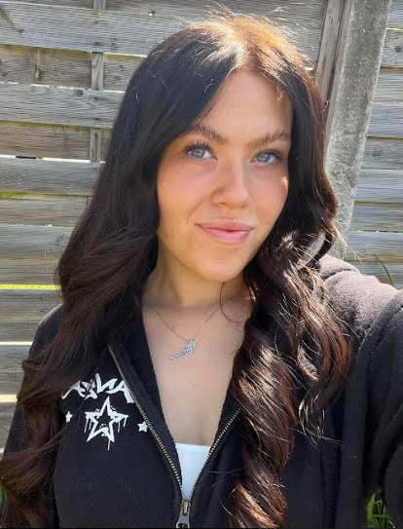
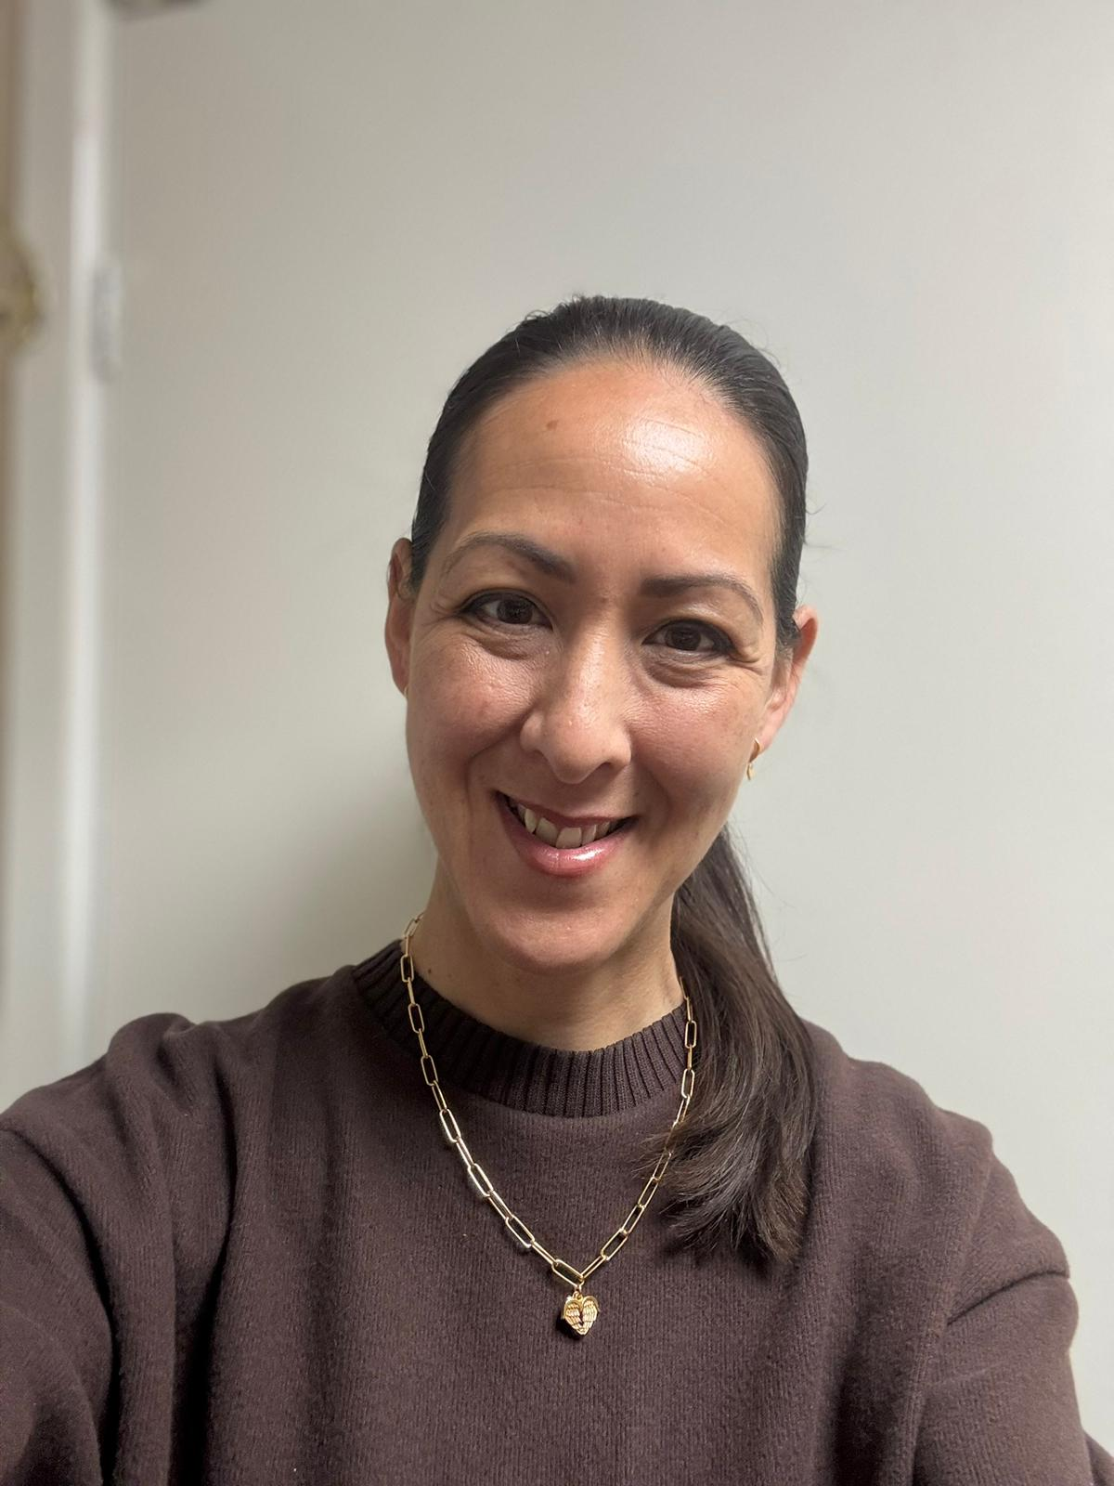
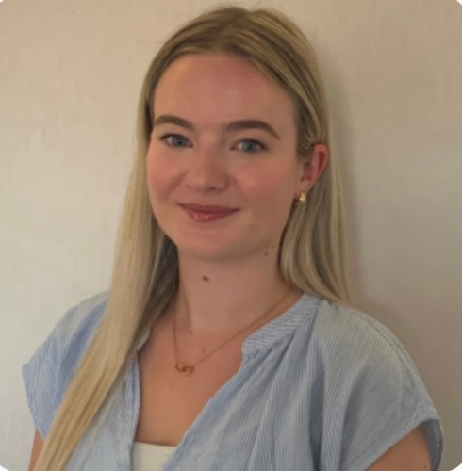
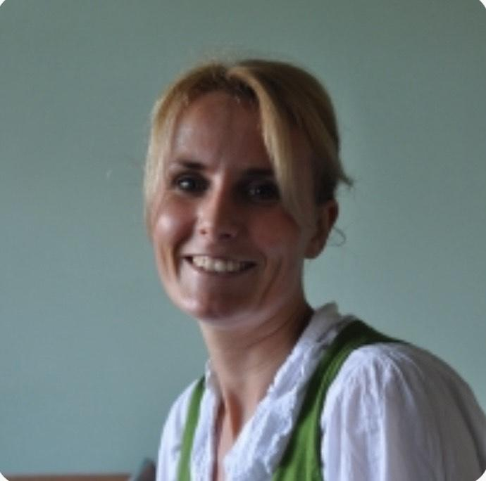
Foundation 2 Staff
Robins Class
Mrs Cooper Miss Barrow Mrs Salisbury
Kingfishers Class
Miss Collinson Mrs Green

Slide 5
Who are we?
We aim to provide a happy, relaxed environment where children are encouraged and supported to achieve their full potential and to develop an attitude of care and responsibility towards others and their surroundings.
We ensure that the children in this school will attain the highest standards of which they are capable. We encourage the children to be independent and self-confident and we believe that this can be achieved more readily when teachers, parents and pupils work together in partnership.

Slide 6

School Rules
This year we have taken on our new school rules – Ready, Respectful, Safe
Ready – Correct uniform, reading book, listening, lining up
Respect – For our school community and our environment
Safe – Looking after each other, online safety, stranger danger

Slide 7
Topic outline for this year will be:
Autumn
Maths –Counting / Pattern
Literacy – Storytime/Phonics
PSED – Being Me in My World
Physical – Dance/Fine motor
Understanding of the world – Autumn
Art and design – colour/autumn/cooking
Curriculum overviews for each half term will be on the class page on the school website. The link to this will be sent out each half term alongside any key information and PE days.

Slide 8
Trips
In F2 we try and visit Nanny Sharon’s, the cinema and the library half termly.
We will inform you about local visits (e.g. church) as well. Walkers are always needed so please let us know if you can help!
If anyone would to volunteer to help in school please let us know.

Slide 9
HOMEWORK
Practice phonemes taught that week
Practice writing phonemes
Daily reading when given a book
Additional themed homework given out via tapestry.

Slide 10


Reading in year ……:
Each child is expected to ‘Strive for five’ – this means
reading at least 5 times a week at home.
Reading books will be sent home on a Thursday and returned on a Friday. Please ensure your child’s book is in their blue bags at all times.

Slide 11
Water Bottles
Please make sure that these are named – water or sugar free cordials/squash only. No fizzy drinks please. Drinks will be stored and children will have regular access to them at appropriate times.
Wellies
Please send a pair of labelled wellies into school asap. The children are only allowed t play in the gated area of the playground if they have wellies on.
Snacks
Fruit is available throughout the day. Each child is allowed 1 piece of fruit per day. Snack will be provided in the afternoon at a cost of £5 per half term. We will let you know what is owed vis tapestry.
Label
Please label clothes (especially jumpers).
School Meals
The menu is available, please discuss the choices you made with your child so they are familiar with their choices. We will endeavour to let you know any changes ahead of the day.
PLEASE REMEMBER WE ARE A NUT FREE SCHOOL DUE TO ALLERGIES.

Slide 12
Forest School
Forest school will take place next half term on a Friday morning.
Children will need come into school in clothes that can get dirty and possibly wet. They can wear their school wellies so will not need different footwear.
Please only send your child’s puddle suit in on their Forest School day unless asked otherwise.
It is vital they can get their own puddle suit on and off so please practice at home. Send an alternative coat in a labelled bag.

Slide 13
Friday Assembly
Each week we will pick two of our children to receive an award for a special achievement that week – chosen by the class
Parents will be informed on the Friday of the week before and can attend the assembly on a Friday at 2:40pm.
The children who receive a certificate will have a hot chocolate and time to share their learning the following week with Mrs Grimster or Mrs Cooper.

Slide 14
Time off school
In case of illness: phone school office before 9.30am
Requested time off school: please email the school office to explain why it is exceptional. A leaflet explaining fixed penalty notices has been sent out in July regarding new rules.
We are expected to issue Fixed Penalty Notices for more than 10 sessions (1 day = 2 sessions) of unauthorised absence in a ten week period.
We do monitor late arrivals and those who have regular time off school and will be in touch where necessary to offer support.
The gate opens at 8.40am and closes at 8.55am. There are learning activities in classrooms from 8.40am so please ensure a prompt arrival.

Slide 15
Communication and Progress
As a school we want to keep parents and carers up-to-date with their child’s education and what is happening in school.
All information will be sent through E-Schools emails and Tapestry in F2.
At the start of each half term your class teacher will send you a message regarding all information for that half term and the link to the class page for curriculum information
Important Dates poster overview will be sent out each half term
Fortnightly newsletter
A member of staff on the doors every morning to pass important messages to and Mrs Grimster will be on one of the gates too
Follow our Greasby Infant School Facebook page for celebrations of what we have been up to!
Invitation to our praise assembly if your child is receiving one of the certificates. These will be sent on a Friday evening for the following Friday.
2 Parents Evenings – November and March 3:30-6:00pm.
One end of year report with option for meeting from this if needed.
If the class teacher has any concerns regarding your child’s progress they will arrange a meeting with you to discuss about steps to support them

Slide 16
Questions and Concerns
If you have questions or concerns please let us know so these can be dealt with promptly. Please understand that a teacher or member of staff may not be able to respond on the same day due to their teaching commitments and will not outside of their working hours.
A new home school communication charter is being created to ensure clear and effective partnership between school and families. This will be sent out this half term.
Parental ‘What’s app’ groups are very helpful but please come directly to school staff with questions e.g. Why is my child having a baked potato each day?

Slide 17
Who to speak to at Greasby…
First port of call should always be your child’s teacher.
Headteacher – Mrs Grimster
headteacher@greasby-infant.wirral.sch.uk
Deputy Headteacher – Mrs Cooper
scooper@greasby-infant.wirral.sch.uk
SENCO – Miss Jones
hjones@greasby-infant.wirral.sch.uk
School Office
schooloffice@greasby-infant.wirral.sch.uk

Slide 18

FOGIS
Involving yourself with the FOGIS is important.
If you would like to get involved please email
fogis2023@gmail.com
_____
We need your support ~ thank you.
FOGIS

Slide 19



Great Websites :
Spelling Frame
BBC Bitesize
Spell Zone (word lists)
The School Run
(for parents!)
Great Apps :
Squeebles
Hit the Button
Doodle Maths

